Slide 1

Note: The data and information in this document is reflective of a hypothetical situation and client. This document is to be used for KPMG Virtual Internship purposes only.
Sprocket Central Pty Ltd
Data analytics approach
Agbetanmije Olayinka

Slide 2
Note: The data and information in this document is reflective of a hypothetical situation and client. This document is to be used for KPMG Virtual Internship purposes only.
Agenda
Introduction
Data Exploration
Model Development
Interpretation

Slide 3
Note: The data and information in this document is reflective of a hypothetical situation and client. This document is to be used for KPMG Virtual Internship purposes only.
Introduction
Identify and Recommend High Value Customers
Problem outline
Sprocket Central Pty Ltd specializes in high-quality bikes and accessible cycling accessories to riders.
Their marketing team is looking to boost business by analyzing their existing customer dataset to determine customer trends and behavior.
Using 3 datasets, the aim is to recommend which of the 1000 new customers should be targeted to drive the most value for the organization.
Content of Data Analysis
Bike related purchase by Gender
Bike relate purchase by Age
Number of cars owned and not owned by States
Wealth segment by Age category
Top industry contributing the maximum profit and bike related sales
RFM analysis and Customer segmentation

Slide 4
Note: The data and information in this document is reflective of a hypothetical situation and client. This document is to be used for KPMG Virtual Internship purposes only.
Data Exploration
Data Quality Assessment
Standard Data Quality Dimensions
Accuracy: correct values
Completeness: data fields with values
Consistency: data free from contradiction
Currency: values up to date
Relevancy: data items with value meta-data
Validity: data containing allowable values
Uniqueness: data that are duplicated

Slide 5
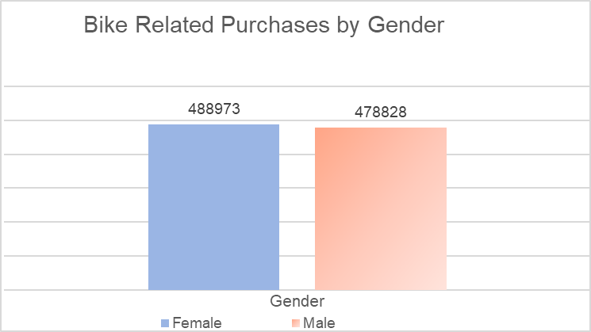
Note: The data and information in this document is reflective of a hypothetical situation and client. This document is to be used for KPMG Virtual Internship purposes only.
Data Exploration
Bike Related Purchase Over The last 3 Years Based on Gender
In the past three years, Females had purchased more bikes-related items than males.
Females purchased more than 10,000 (1%) more bikes than males.

Slide 6
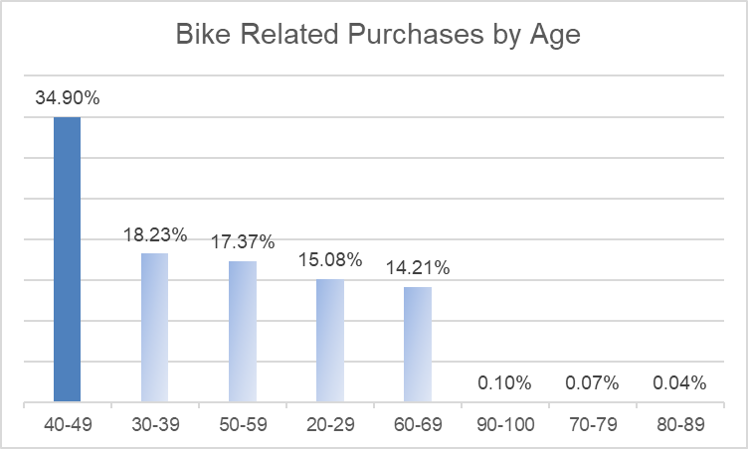
Note: The data and information in this document is reflective of a hypothetical situation and client. This document is to be used for KPMG Virtual Internship purposes only.
Data Exploration
Bike Related Purchase Over The last 3 Years Based on Age Category
People between the ages of 40 and 49 have made the most bike-related purchases in the last three years.
People between the ages of 40 and 49 accounted for nearly 35% of all bike purchases.

Slide 7
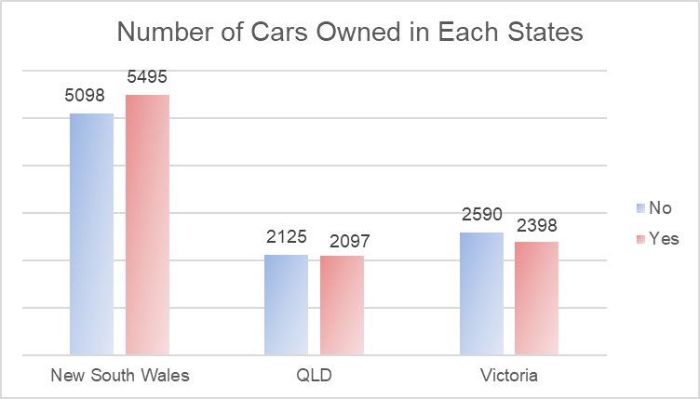
Note: The data and information in this document is reflective of a hypothetical situation and client. This document is to be used for KPMG Virtual Internship purposes only.
Data Exploration
Number of Cars Owned And Not Owned By States
People in New South Wales have the most potential. The number of people who own a car is nearly equal to the number of people who do not, indicating that there is a high probability of finding valuable customers there.

Slide 8
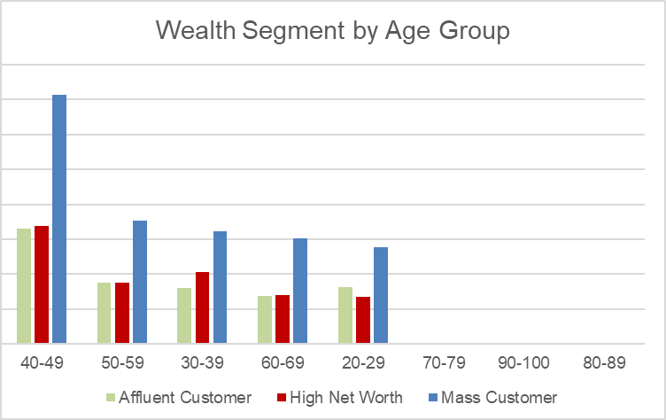
Note: The data and information in this document is reflective of a hypothetical situation and client. This document is to be used for KPMG Virtual Internship purposes only.
Data Exploration
Wealth Segment By Age Category
Among the wealth segments, the mass customer segment has the highest profit.
Mass customer aged between 40-49 are more likely to bring in more profit for the company than other age groups.

Slide 9
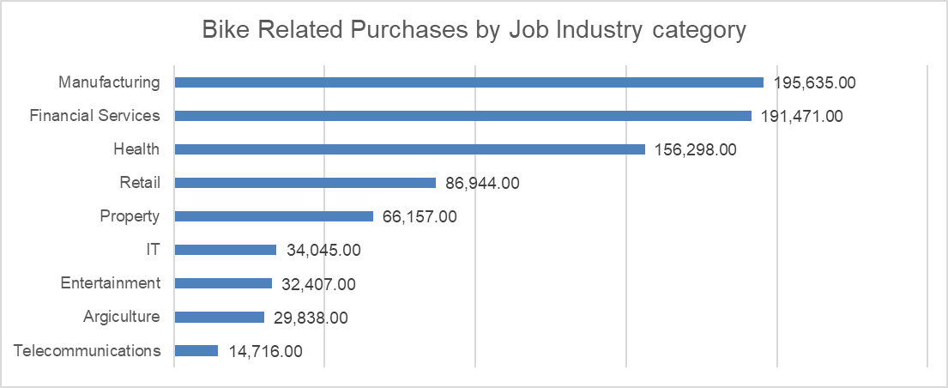
Note: The data and information in this document is reflective of a hypothetical situation and client. This document is to be used for KPMG Virtual Internship purposes only.
Data Exploration
Top Industry Contributing The Maximum Profit And Bike Related Sales
Manufacturing, Financial Services, and Health are the top three job categories that contribute the most profit and have the most bike-related purchases.
The top job category accounts for 67.3% of all bike-related purchases.

Slide 10
Note: The data and information in this document is reflective of a hypothetical situation and client. This document is to be used for KPMG Virtual Internship purposes only.
Model Development
Customer Segmentation Using RFM Analysis
RFM analysis is used to determine which customers a company should focus on in order to increase revenue and profit.
RFM (Recency Frequency Monetary) analysis, also known as RFM segmentation, is a powerful customer segmentation technique that can help you improve your marketing.
The analysis allows you to target only specific customer segments that will benefit your business in the future.

Slide 11
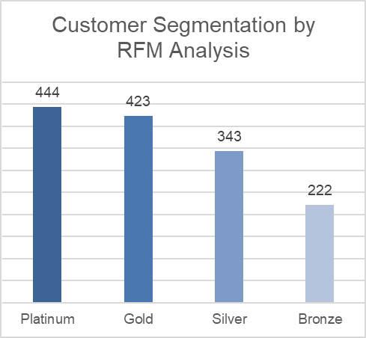
Note: The data and information in this document is reflective of a hypothetical situation and client. This document is to be used for KPMG Virtual Internship purposes only.
Model Development
Customer Segmentation Using RFM Analysis
Using RFM analysis, we classified customers into four segments; Platinum, Gold, Silver, Bronze.
Platinum Customers: Most Profitable customers. They are purchase most frequently, has the highest value and is the most recent
Gold Customers: The profitability is not as high as the Platinum Tier. They purchase a little less frequently, and a little less recent.
Silver Customers: They provide essential revenue but their loyalty and profitability is not substantial enough to the company.
Bronze Customers: They are infrequent Customers.

Slide 12
Note: The data and information in this document is reflective of a hypothetical situation and client. This document is to be used for KPMG Virtual Internship purposes only.
Interpretation
Customer Target
The 1000 new customers to be targeted should:
Be from the Platinum and Gold customers segment. They would have purchased more recently, purchased more frequently in the past and tends to spend more than other customers.
Most of them will be female compare to male.
Working in the industries of Manufacturing, Financial Services, and Health.
Currently residing in the states of New South Wales and Victoria.

Slide 13
Note: The data and information in this document is reflective of a hypothetical situation and client. This document is to be used for KPMG Virtual Internship purposes only.
Appendix

